Slide 1
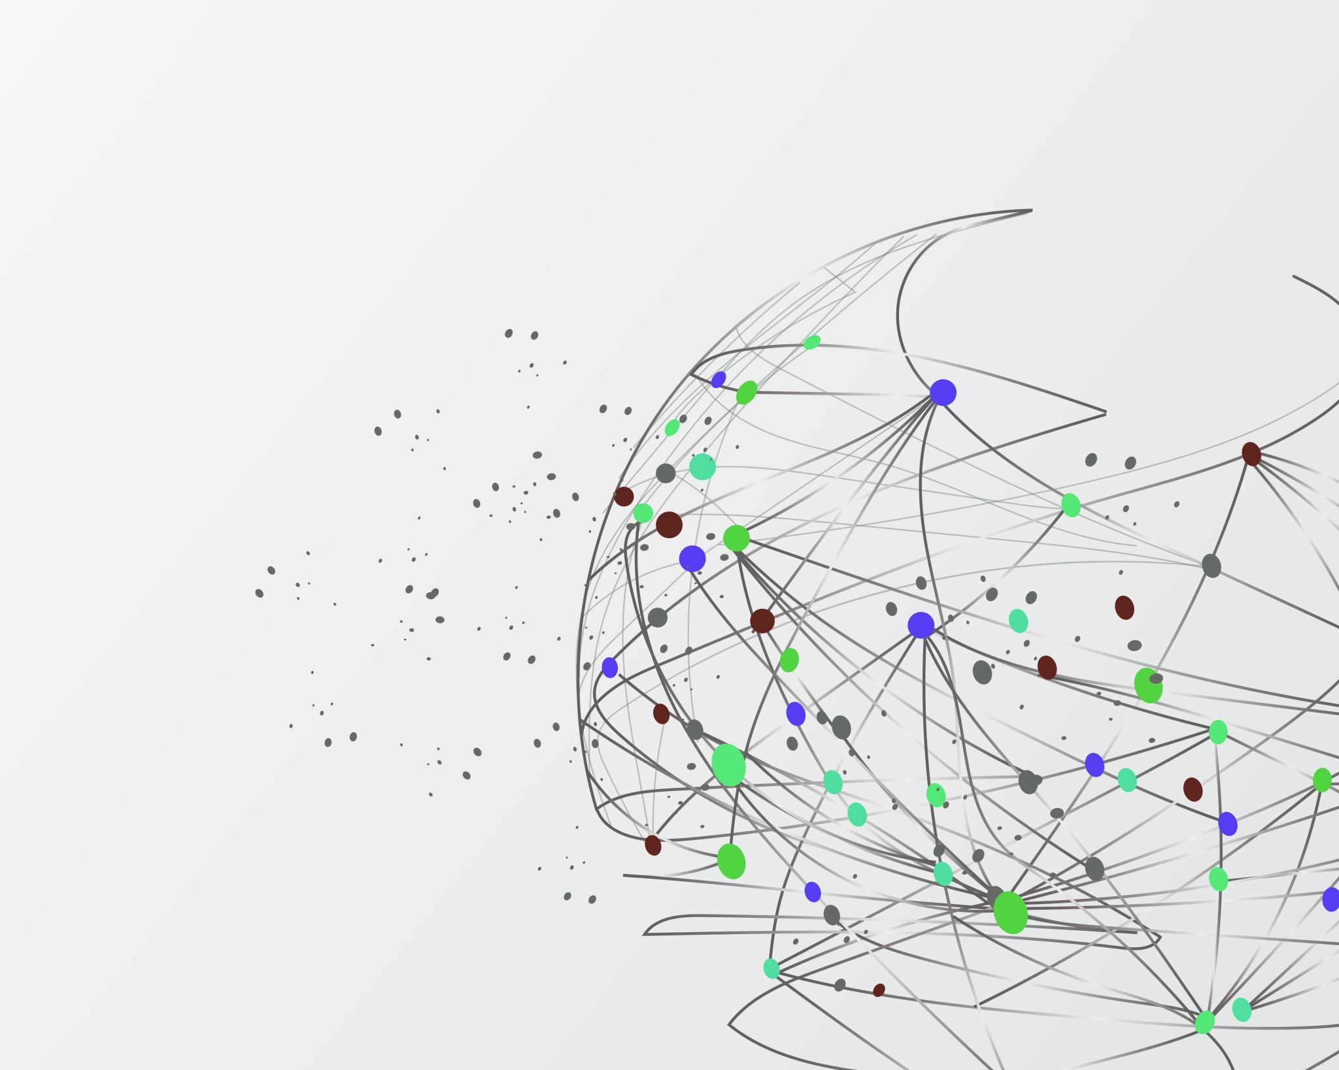
ULK GISENYI CAMPUS
KIGALI INDEPENDENT UNIVERSITY
Class:year2 networking
Rolle number:202421034
Le 22/11/2025
Coud computing assignment

Slide 2
Answer of all activities
1.A Region: is a physical geographic area where a cloud provider has multiple data centers. Each region operates independently and allows users to choose where their applications and data will be stored.
Example: AWS regions like us-east-1 (USA) or eu-west-1 (Europe).
2. Availability Zone (AZ):is a group of one or more isolated data centers within a region. Each AZ has separate power, cooling, and networking.AZs allow applications to remain available even if one AZ fails
3. Local ZoneA : is an extension of a cloud region located closer to users in specific cities. It provides low-latency (very fast) access for applications like gaming, streaming, and real-time processing.

Slide 3
4. VPC (Virtual Private Cloud):A VPC is a private virtual network in the cloud where you can run your resources securely.In a VPC, you control IP address ranges, subnets, routing tables, and security settings.
5. Subnet: is a subdivision inside a VPC. It helps organize resources.
There are:
Public subnets → connected to the internet.
Private subnets → isolated, no direct internet connection.
GitHub Section
6. What GitHub :is an online platform for storing code, collaborating on projects, and tracking changes using Git version control. Developers use it to work together and manage software projects.

Slide 4
7. Create an Account on GitHub
Steps:
Go to github.com
Click Sign Up
Enter your email, password, and username
Verify the account
8. Create a GitHub Repository:
Log in to GitHub.
Click New Repository.
Give it a name.
Choose Public or Private.
Click Create Repository.

Slide 5
9. Push Your Assignment to GitHub.
You upload your assignment files to your GitHub repository using:
GitHub Desktop, or
Git commands, or
Uploading directly through the browser.
10. Clone the Assignment for Verification
Cloning means downloading a copy of the repository from GitHub to your computer.
You can do this using:
Git clone command, or
GitHub Desktop Clone option.
The End!!!!

